Slide 1
Boosting
Let us handle biasing

Slide 2
Boosting(HBLV)
Boosting is a machine learning ensemble technique that combines the predictions of multiple weak learners to create a strong learner.
Weak learners are models that perform slightly better than random chance.

Slide 3

The idea is to build the strong model incrementally, by sequentially adding weak models(WM) that are trained to correct the mistakes made by existing ensemble approach.
If the base model is highly biased than boosting technique is going to help us in reducing the bias.

Slide 4
Basic Idea:
Boosting works iteratively. It starts by fitting a weak learner to the original dataset.
Where weak learner means a decision tree with one depth(shallow decision tree).
Then, it gives more weight to the instances that were misclassified by the first learner.
In subsequent iterations, it focuses more on the previously misclassified instances, effectively "boosting" the performance of the ensemble.

Slide 5
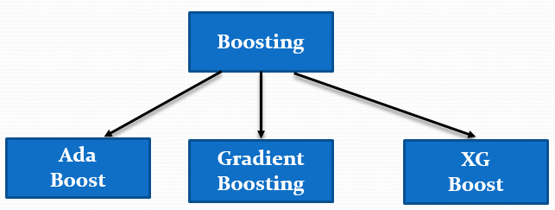
Classification of Boosting

Slide 6
AdaBoost (Adaptive Boosting):

Slide 7
Ada boost : Specially popular in image classification before CNN and Deep Learning, but not first choice nowadays in ML.
But understanding the concept of math behind Ada Boost helps to understand the advance concept of Gradient Boosting and XG Boost.

Slide 8
AdaBoost assigns weights to each training instance and adjusts the weights at each iteration.
It increases the weights of misclassified instances.
While decreases the weights of correctly classified instances.

Slide 9
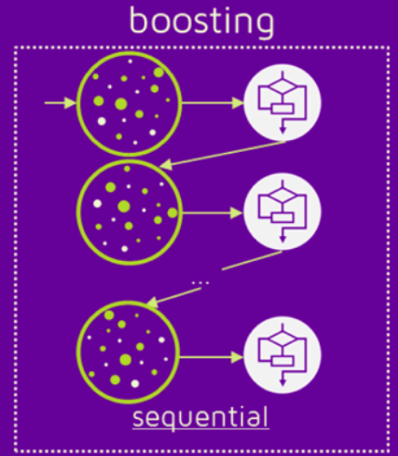
Additive Modelling Idea
It is a kind of additive modeling.
Where the boosting builds the model in a stage-wise manner by adding one weak learner at a time.
F(x) = f1(x) + f2(x)+…………….. + fn(x)

Slide 10
Things to kept in mind:
Weak learner( accuracy just >=50%)
Decision Stump: It is a tree with one node and two leaves.(shallow tree i.e. max depth = 1) or only one decision in a model.
They are not good at making accurate classifications. They are technically "weak learners".
+1 and -1( positive and negative)

Slide 11
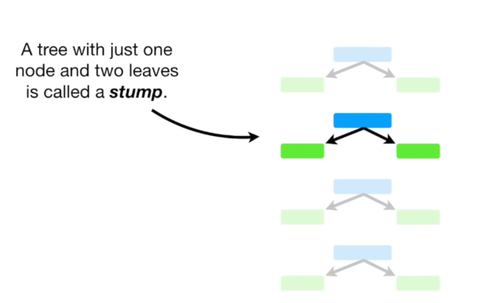

Slide 12
Algorithm Steps:
Step 1:Initialize instance weights uniformly.
Step 2:Train a weak learner on the weighted dataset.
Step 3:Calculate the error of the weak learner.
Step 4:Adjust instance weights based on the error.
Increase the weights of misclassified instances and decrease the weight of correctly classified.
Step 5:Repeat until a predefined number of weak learners is reached.

Slide 13
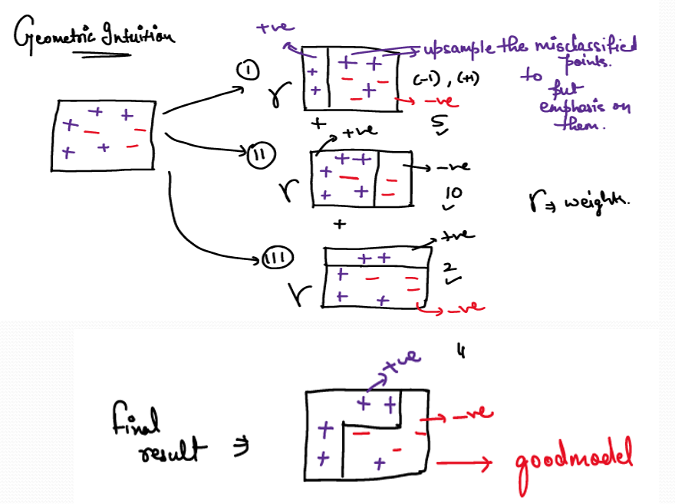

Slide 14
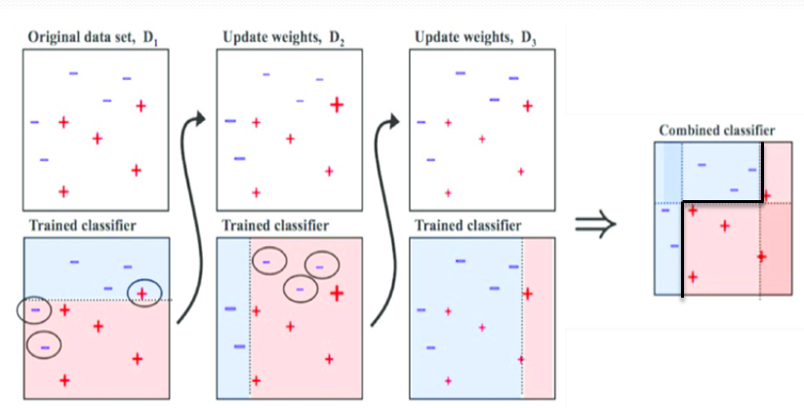
Stage wise Additive method

Slide 15
ADA boost with numerical example
Suppose we have a simple dataset with n observation and for model making took n1 samples.:
X1 | X2 | X3 | Y | Sample weight
- | - | - | 1 | 1/5
- | - | - | 0 | 1/5
- | - | - | 1 | 1/5
- | - | - | 0 | 1/5
- | - | - | 1 | 1/5

Slide 16
Step 1:
Initialization:
Weights are initialized uniformly: 1/no of rows
𝑤1=𝑤2=𝑤3=𝑤4=𝑤5 = 1/5
Step 2:
Calculate total error: sum of sample weight for wrong prediction. Here it is : (1/5)+(1/5) = 2/5
X1 | X2 | X3 | Y | Status | Sample weight | Total Error
- | - | - | 1 | Correct | 1/5 | = 2/5 = 0.4
- | - | - | 0 | Wrong | 1/5
- | - | - | 1 | Correct | 1/5
- | - | - | 0 | Wrong | 1/5
- | - | - | 1 | Correct | 1/5

Slide 17
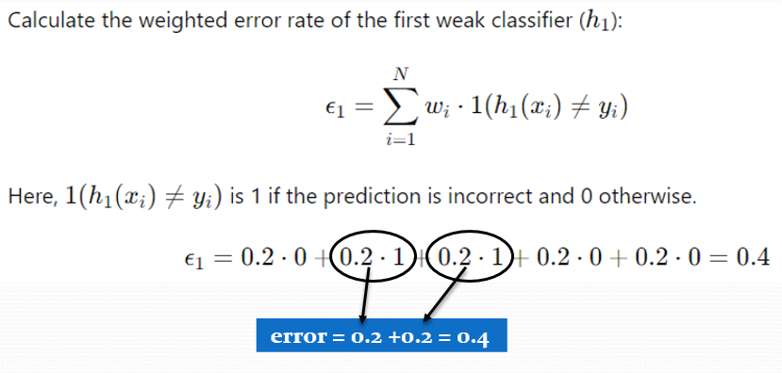

Slide 18

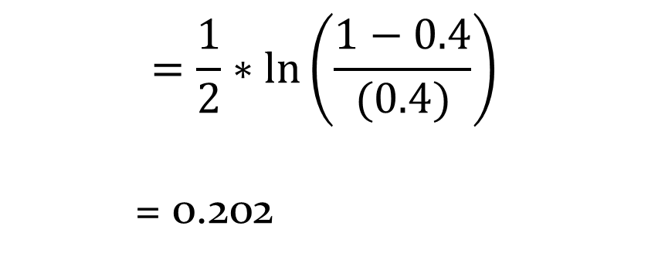
Step 3: Calculate alpha:
Based on the error, calculate alpha that will be used to adjust the weight.
If error is small → α large → model trusted more
If error close to 0.5 → α small → model weak
$$=\frac{1}{2}∗\ln\left(\frac{1−0.4}{(0.4)}\right)$$
= 0.202

Slide 19
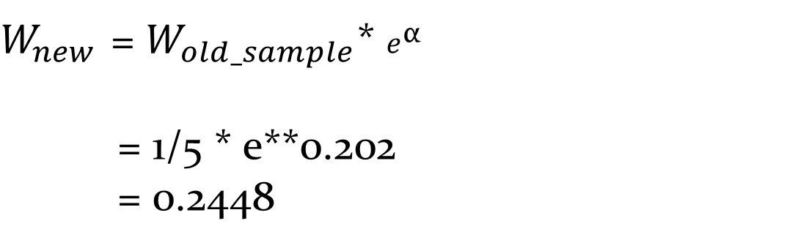
Step4:
Increase the weight of wrongly classified
New sample weight = (old sample weight) * e**(α)
$W_{new }$= $W_{old_sample}$* $e^{\text{α}}$
= 1/5 * e**0.202
= 0.2448

Slide 20
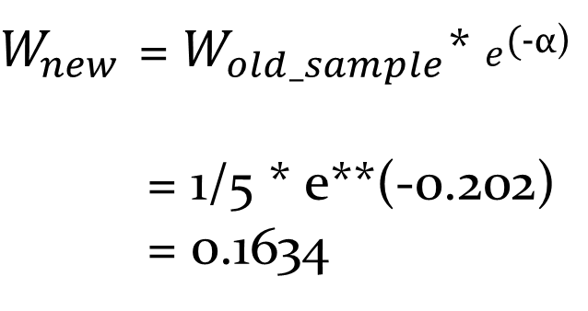
Step 5:
Decrease the weight of correctly classified.
Thus make a new column as new weight with updated weights.
New sample weight = (old sample weight) * e**(-α)
$W_{new }$= $W_{old_sample}$* $e^{\text{(}\text{-}\text{α}\text{)}}$
= 1/5 * e**(-0.202)
= 0.1634

Slide 21
Step 6: Update the weight
X1 | X2 | X3 | Y | Sample weight | Updated Weight
- | - | - | 1 | 1/5 | 0.1634
- | - | - | 0 | 1/5 | 0.2448
- | - | - | 1 | 1/5 | 0.1634
- | - | - | 0 | 1/5 | 0.2448
- | - | - | 1 | 1/5 | 0.1634

Slide 22
Step 7:Normalize the weight:
Y | Status | Sample weight | Updated Weight | Normalized
1 | Correct | 1/5 = 0.2 | 0.1634 | 0.1634/1.0612 =0.154
0 | wrong | 1/5= 0.2 | 0.2448 | 0.2448/1.0612 =0.231
1 | Correct | 1/5= 0.2 | 0.1634 | 0.1634/1.0612 =0.154
0 | Wrong | 1/5= 0.2 | 0.2448 | 0.2448/1.0612 =0.231
1 | Correct | 1/5= 0.2 | 0.1634 | 0.1634/1.0612= 0.154
 |  | = 1 | = 1.0612 | = 1
The process of iteration go till the error become zero or close to zero.

Slide 23
Y | Status | Normalized | Range
1 | Correct | 0.1634/1.0612 =0.154 | 0- 0.154
0 | wrong | 0.2448/1.0612 =0.231 | 0.154-0.385
1 | Correct | 0.1634/1.0612 =0.154 | 0.385-0.539
0 | Wrong | 0.2448/1.0612 =0.231 | 0.539-0.770
1 | Correct | 0.1634/1.0612= 0.154 | 0.770-1.000
 |  | = 1
**Bigger range ⇒ higher chance of selection

Slide 24
The cumulative addition of normalized weights is used to create a probability distribution for resampling.
Range: The cumulative addition of normalized weights shows the probability intervals. The larger ranges (e.g., 0.166 - 0.416) indicate that misclassified samples have a higher chance of being selected in the next iteration.
The "Range" is a visual representation that shows how the model will give more importance to previously misclassified samples in the next iteration.

Slide 25
Step 6: Continue the process till the results get optimized in terms of time, memory and overfitting with correct classification.
*Note*
## AdaBoost was popular one for image classification before deeplearning and CNN.

Slide 26

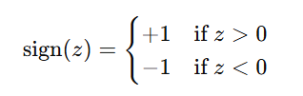
Final Model
Each weak learner contributes based on its importance (α)

Slide 27
Model | Prediction (hi(x)) | Weight (αi)
h₁ | +1 | 0.5
h₂ | -1 | 0.3
h₃ | +1 | 0.2
Three models are trained sequentially, but their predictions are combined to give the final decision.

Slide 28
Why Boosting reduces Bias
Model | Bias | Variance
Decision Tree | Low | High
Random Forest | Low | Lower
Boosting | Low bias | Controlled variance
**Boosting corrects previous mistakes sequentially.

Slide 29
Difference between Bagging and Boosting
Feature | Bagging | Boosting
Training | Parallel | Sequential
Sampling | Bootstrap | Weighted
Focus | Reduce variance | Reduce bias
Example | Random Forest | AdaBoost

Slide 30
Gradient Boosting:
Gradient Boosting optimize the model by minimizing a loss function, which measures how well the model's predictions match the actual data.

Slide 31
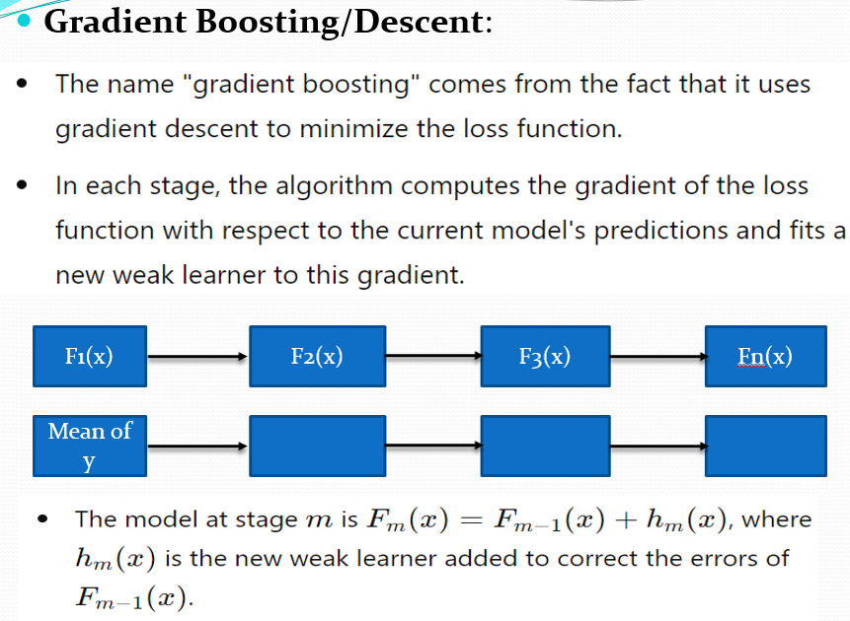

Slide 32
Interpretation of F1(x)
Term | Meaning
F1(x) | Initial model = mean(y)
Type | Constant model
Depends on x? | ❌ No
Value | Same for all inputs

Slide 33
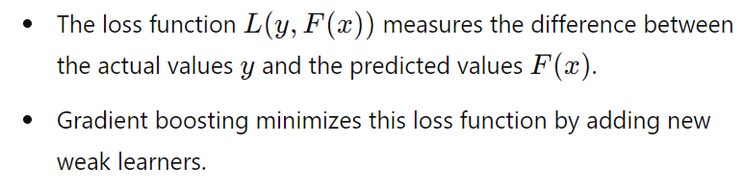

Each weak learner focuses on improving the overall model by addressing the errors (residuals) of the previous ensemble.
Loss Function:
${ L(y}_{i},F(xi)= \frac{1}{2}\sum_{i}^{n}{{(yi−F(xi))}^{2}}$

Slide 34
Algorithm behind Gradient boosting
Inputs for start: training set{(xi,yi)}for n values, Differentiable loss function Number of iterations M

Slide 35
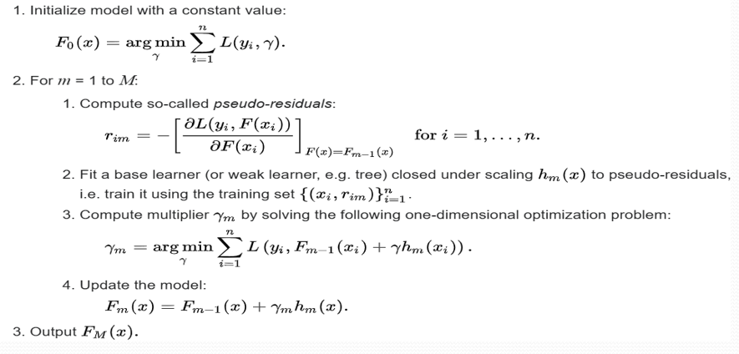
Essentially mean of yi
Negative gradient
The negative sign is used because: We want to move in the direction that reduces loss.

Slide 36

Γm = What is the best step size for this iteration?
γₘ is like an adaptive learning rate per iteration
γₘ controls: Contribution of new learner
In this step, we calculate the optimal value of γ (gamma) that minimizes the loss function.
Here, yi​ is the actual value, Fm−1(xi) is the prediction from the previous model, and hm(xi) is the output of the new weak learner (trained on pseudo residuals).
Gamma determines how much of the new model should be added to the previous model to minimize the loss.”

Slide 37
Term | Meaning
(yi) | Actual value
(F{m-1}(xi)) | Previous prediction
(hm(xi)) | New model (residual learner)
(γ) | How much to trust new model
Gradient Boosting learns both:
what to add (hₘ(x))
how much to add (γₘ)”

Slide 38
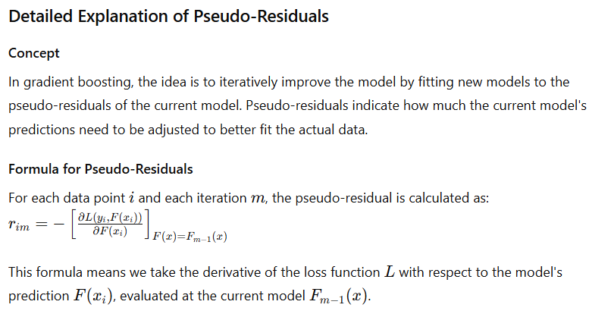

Slide 39
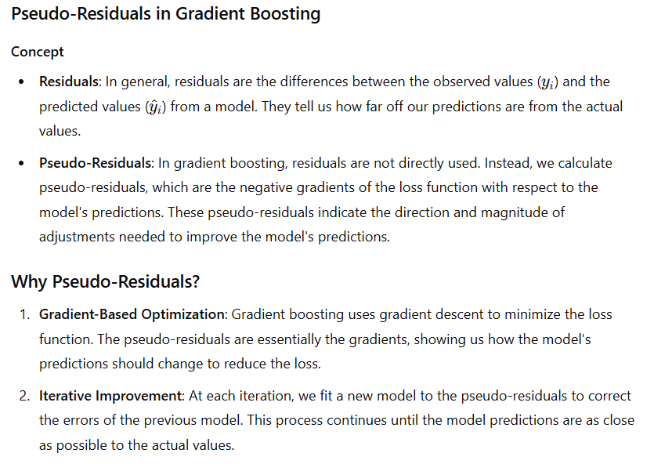

Slide 40
Let us move with an Example

Slide 41
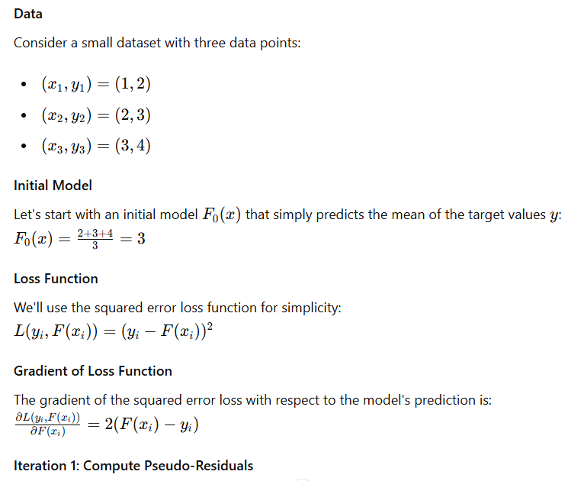

Slide 42
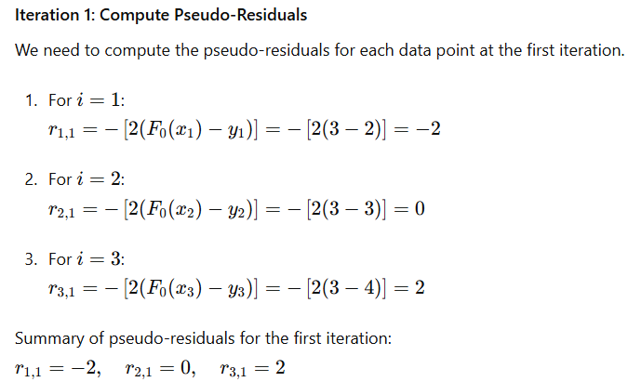

Slide 43
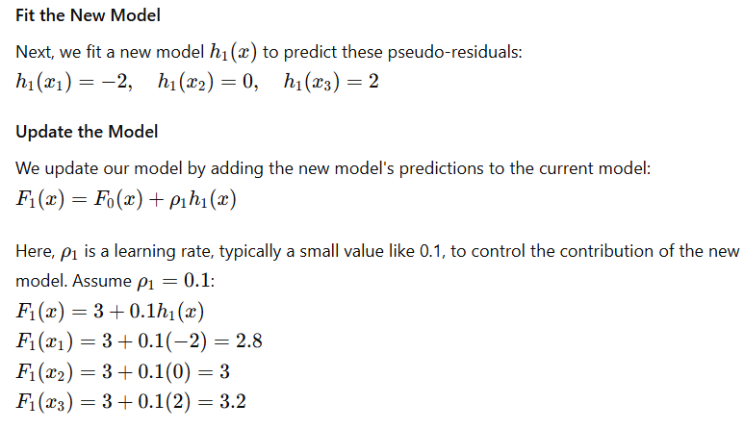

Slide 44
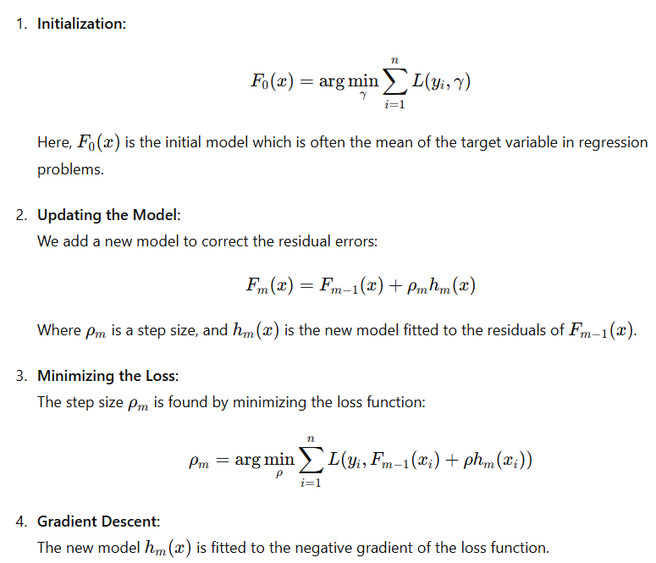
Basic Concepts
Gradient boosting involves iteratively adding models to improve predictions.
It minimizes a loss function by adding new models that correct the errors made by previous models.

Slide 45
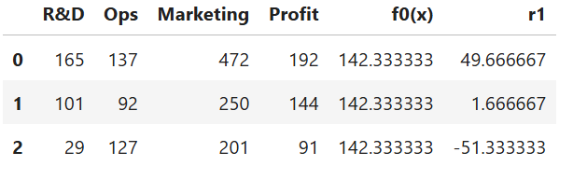
Why first model essentially Mean: Let us understand with the example:
R&D | OPS | Market | Profit
165 | 132 | 472 | 192
101 | 92 | 250 | 144
29 | 127 | 201 | 91

Slide 46
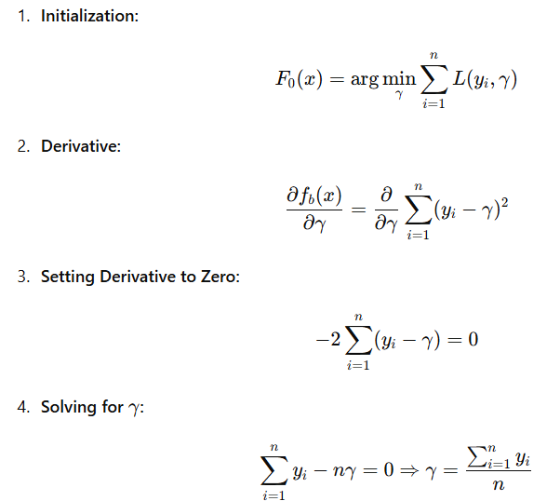
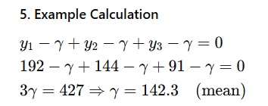
Steps to find the value of F0 ( First model)
Partial derivative of Sq. loss function
Equating derivative of Sq. loss function = zero
Repeat:
Repeat the process for a fixed number of iterations or until the model's performance no longer improves on a validation set.

Slide 47
Final Model
After several iterations, the final model is a weighted sum of all the weak learners. The strength of gradient boosting lies in its ability to iteratively improve the model by focusing on the mistakes made in previous steps, thus leading to a highly accurate model.

Slide 48
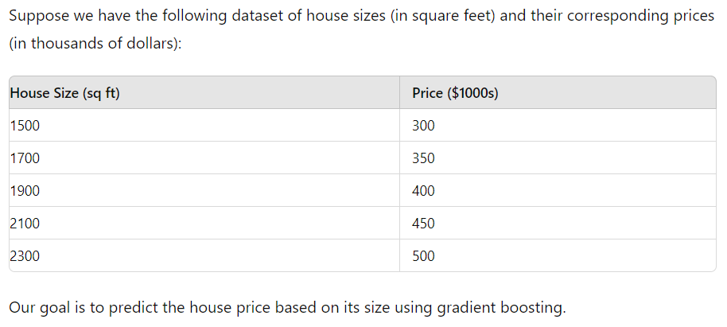
Example: Predicting House Prices

Slide 49
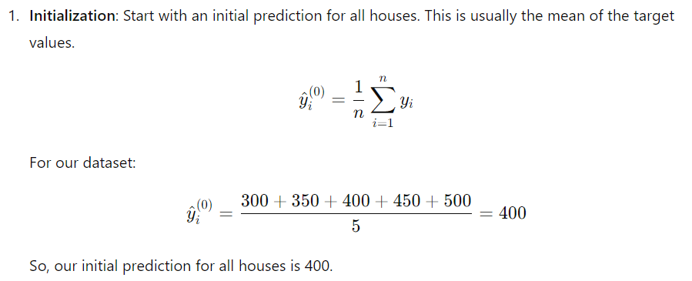
F0​(x)=mean(y)=400

Slide 50
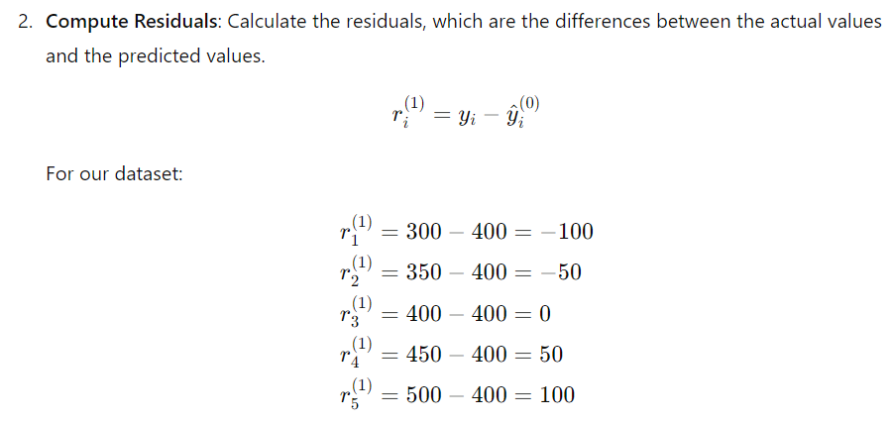

Slide 51
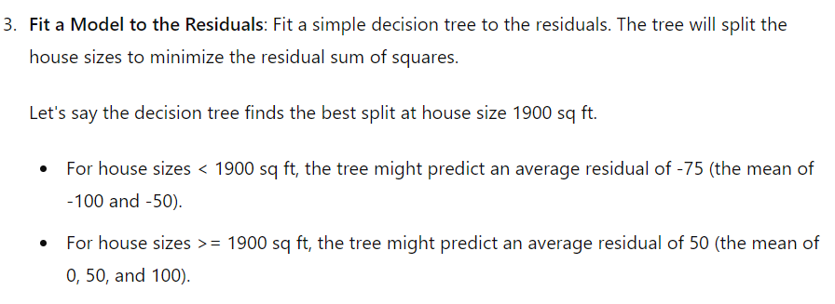

Slide 52
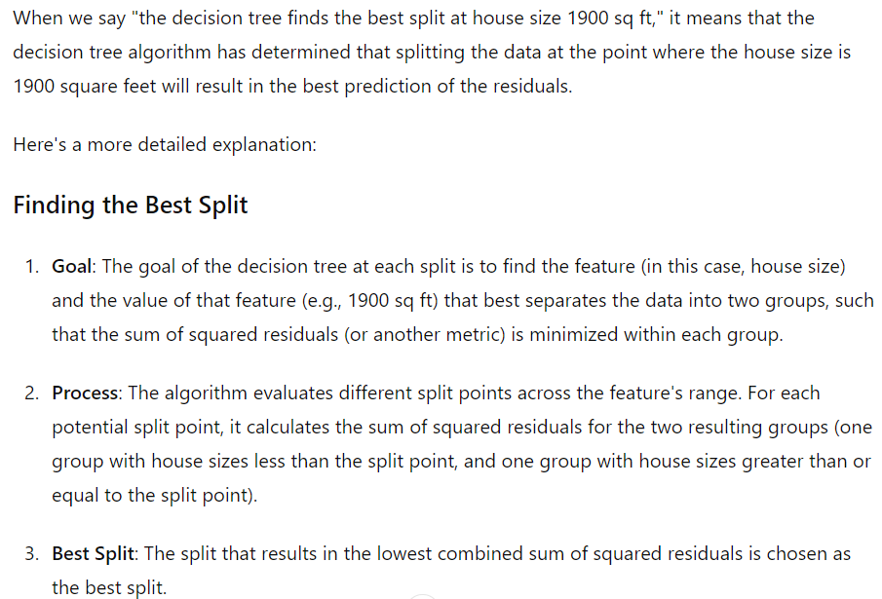

Slide 53
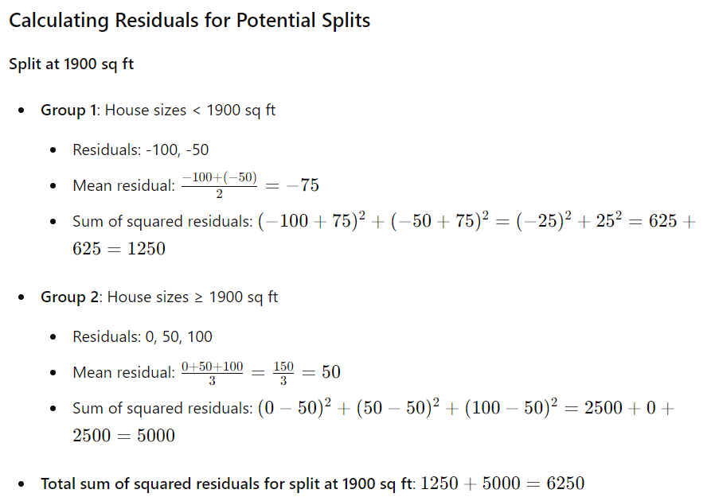
How it works

Slide 54
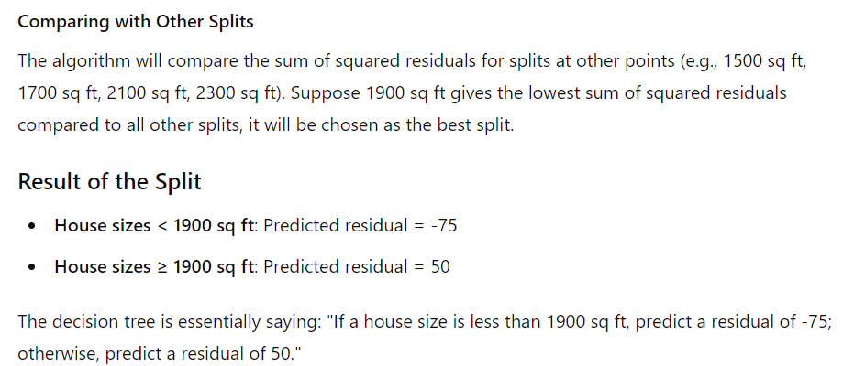

Slide 55
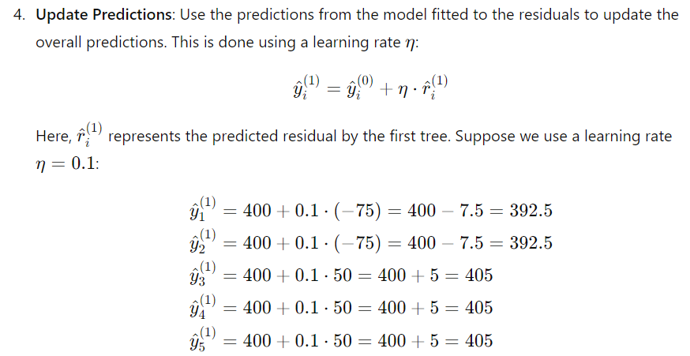
If using some split criterion as discuss in step 3

Slide 56
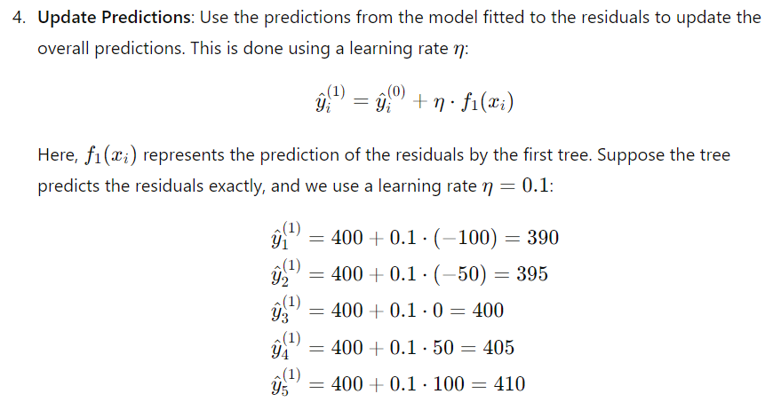

Slide 57
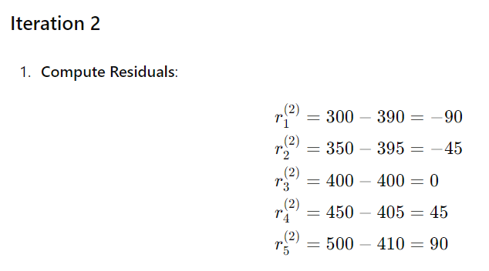

Slide 59
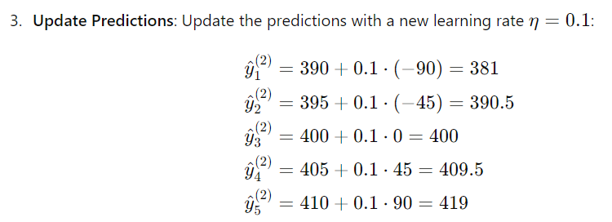
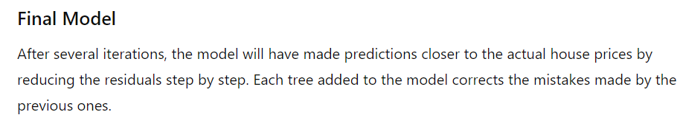

Slide 60

How GB differs from Adaboost
Gradient Boosting:
Boosting Method: Gradient Boosting builds models sequentially, where each new model tries to correct the errors of the previous models. It does this by fitting the new model to the residual errors (the difference between the actual and predicted values) of the previous model.
Loss Function: It explicitly minimizes a specified loss function (e.g., mean squared error for regression, log-loss for classification) using gradient descent. Each new model is added to reduce this loss.
Model Updates: The model at each stage is updated by adding the new model that predicts the residuals. Formally, the model 𝐹𝑚(𝑥) at stage 𝑚 is given by:
where 𝜈 is the learning rate and ℎ𝑚(𝑥) is the new weak learner.
Flexibility: Gradient Boosting is more flexible as it can optimize any differentiable loss function.

Slide 61

Adaptive Boosting (AdaBoost):
Boosting Method: AdaBoost also builds models sequentially, but it adjusts the weights of the training instances based on the errors of the previous models. Instances that are misclassified by previous models get higher weights so that subsequent models focus more on them.
Error Focus: AdaBoost directly uses the classification error to update the weights of the training instances. Each weak learner is trained on the weighted dataset.
Model Weighting: The final model is a weighted sum of the weak learners, where each weak learner is weighted based on its accuracy. Formally, the final model 𝐻(𝑥)) is given by:

Slide 62
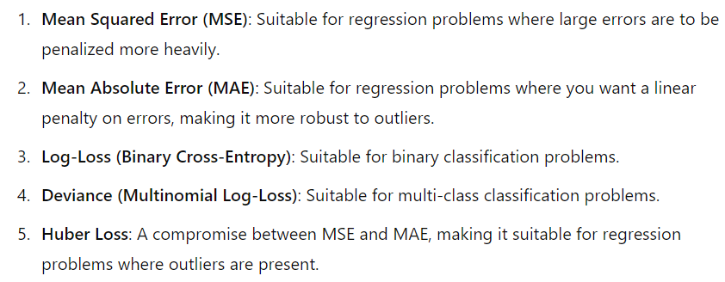
Gradient Boosting with Different Loss Functions
In gradient boosting, you can choose from a variety of loss functions depending on the specific problem and the nature of the data. Common loss functions used in gradient boosting include:

Slide 63
Hyper parameters in gradient boosting
Number of Estimators (n_estimators)
Description: The number of boosting stages (trees) to be built.
Effect: Increasing the number of estimators generally improves the model's performance up to a certain point, after which it can lead to overfitting.
Typical Values: 100 to 1000, but it depends on the complexity of the dataset.

Slide 64
Learning Rate (learning_rate)
Description: Also known as the shrinkage rate, it controls the contribution of each weak learner.
Effect: A lower learning rate requires a larger number of estimators for the model to perform well. It helps in preventing overfitting.
Typical Values: 0.01 to 0.1.
Maximum Depth (max_depth)
Description: The maximum depth of the individual trees.
Effect: Controls the complexity of the trees. Deeper trees can capture more complex patterns but are more prone to overfitting.
Typical Values: 3 to 10.

Slide 65
Max Features (max_features)
Description: The number of features to consider when looking for the best split.
Effect: Reduces overfitting by limiting the number of features each tree can use.
Typical Values: 'auto' (all features), 'sqrt' (square root of the number of features), 'log2' (logarithm base 2 of the number of features).
Loss Function (loss)
Description: The loss function to be minimized.
Effect: Different loss functions are used for regression and classification tasks.
Typical Values: 'deviance' (log-loss for classification), 'exponential' (AdaBoost-like for classification), 'ls' (least squares regression), 'lad' (least absolute deviation for regression), 'huber' (combination of least squares and least absolute deviation).

Slide 66
Alpha (alpha)
Description: The quantile for Huber loss and quantile loss.
Effect: Controls the robustness of the loss function to outliers.
Typical Values: 0.9 for Huber loss.

Slide 67
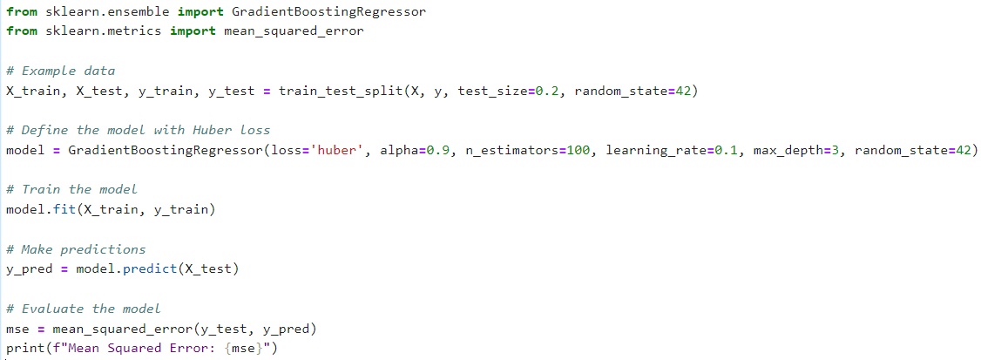

Slide 68
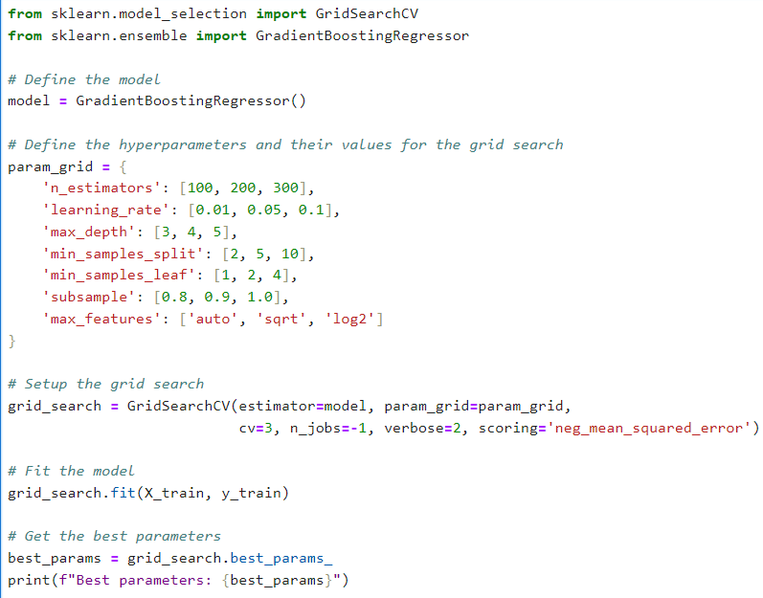

Slide 69
Extreme Gradient Boosting (XGBoost)
Extreme Gradient Boosting, commonly known as XGBoost, is an optimized implementation of the gradient boosting algorithm designed for speed and performance.
It has gained significant popularity due to its efficiency and superior performance in various machine learning competitions and practical applications.

Slide 70
Key Features of XGBoost
Regularization:
XGBoost includes L1 (Lasso) and L2 (Ridge) regularization to prevent overfitting and improve the generalization of the model.
Regularization parameters include alpha (L1 regularization) and lambda (L2 regularization).
Handling Missing Values:
XGBoost has built-in support for handling missing values, automatically learning the best imputation strategy from the data.
Parallel Processing:
XGBoost can leverage multiple CPU cores for parallel processing, making it much faster than traditional gradient boosting implementations.
Tree Pruning:
Instead of growing trees to a fixed depth, XGBoost uses a max-depth parameter along with a minimum loss reduction required to make a further partition, effectively pruning trees during training.
Cross-Validation:
Built-in cross-validation allows for more straightforward model tuning and assessment.

Slide 71
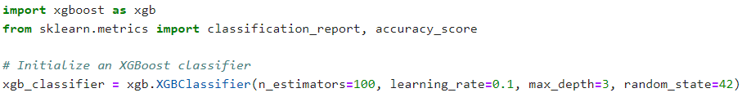
HyperParameters in XGBoost
Here are some of the critical hyperparameters in XGBoost and their typical values:
n_estimator: No of decision tree
eta (learning rate): [0.01, 0.1]
max_depth: Maximum depth of the tree. Typical values range from 3 to 10.

Slide 72
# Keep in Mind:
From Industry point of view three models are sufficient:
Random Forest( high variance)
Gradient Boosting(high bias)
XG Boosting(high bias)

